Slide 1

Food Recipe Manager
Team Name: Phoenix
Pannaga Veeramohan (002189691)
Rajavi Shah (002727823)
Urmi Patel (002772667)

Slide 2
Contents
01
06
02
07
03
08
04
09
05
10
Introduction
Functionalities
Problem Statement
UML Diagram
Approach to solve a problem
Contributions
Topics Covered
Future Scope
Screenshots of Implementation
Tools

Slide 3
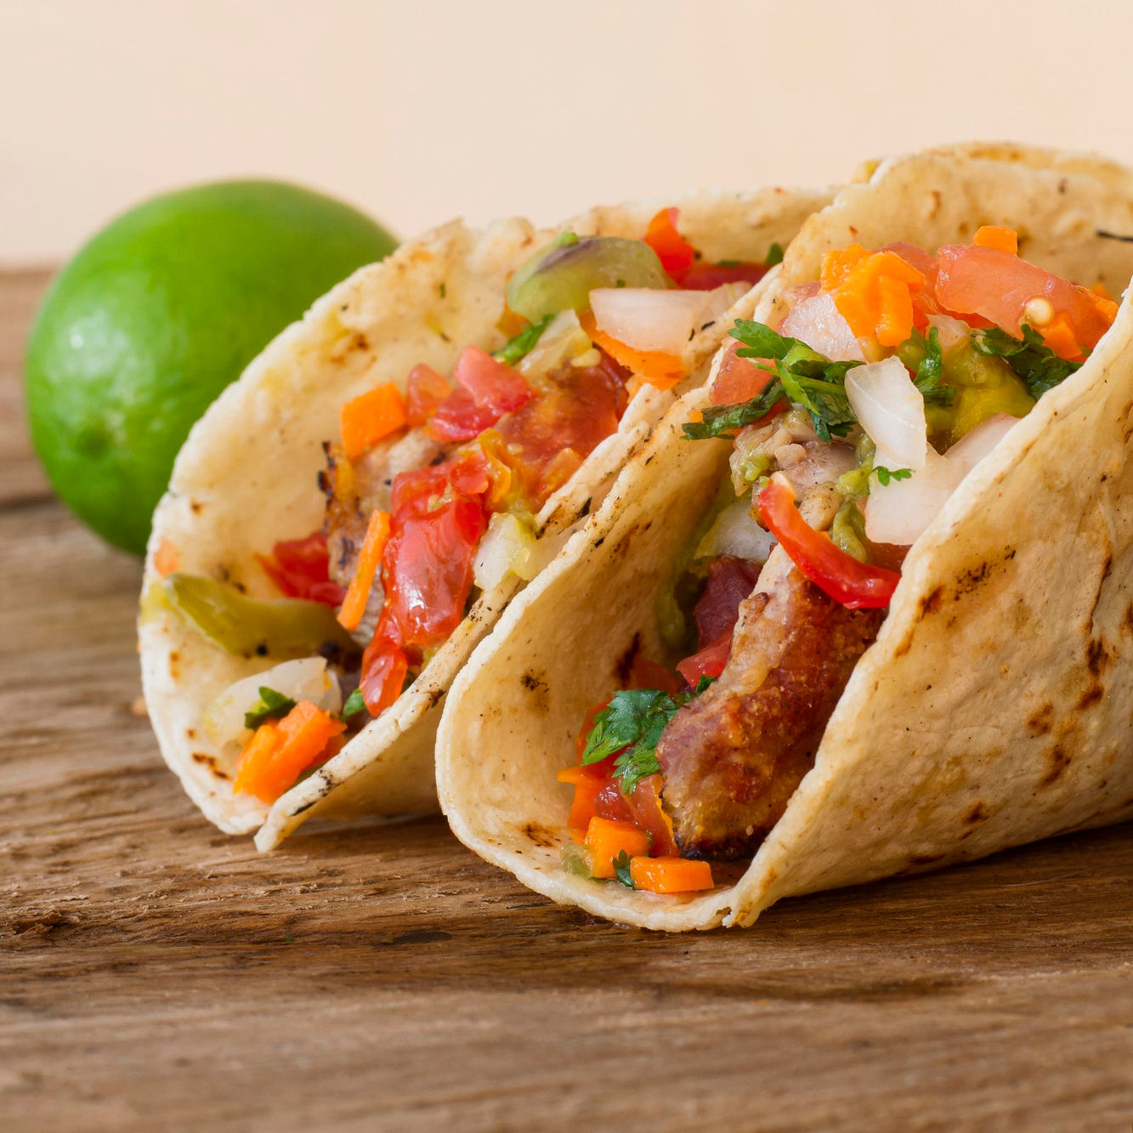
Introduction
Cooking can be an enjoyable and rewarding hobby, but keeping track of recipes can be tedious.
The Food Recipe Manager App is intended to make meal planning and preparation more effective and fun for users.
This application allows users to effortlessly store, search for, and categorize their favorite recipes, as well as create and save meal plans.
The app is simple to use and visually appealing, making it accessible to anyone who wants to simplify their meal planning process.

Slide 4
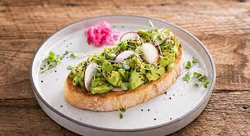
Problem Statement
Without Recipe Manager App, people may face several problems in organising and keeping track of Recipes.
Some of them would be -
Difficulties in finding and organizing recipes
Difficulty in Meal Planning
Difficulty in categorizing
Difficulty in storing your custom tasty dishes!

Slide 5
Approach to solve a problem
The Recipe Manager application allows users to organize and manage their recipe collections digitally.
Recipes can be stored, searched, and categorized, making finding and preparing favorite meals easier.
Use various criteria to search and filter recipes for effective meal planning.
You can keep all your recipes in one place with the Recipe Manager app.
It is overall more efficient and enjoyable to prepare meals with the use of a Recipe Manager application.

Slide 6
Topics Covered
Class Definition
Inheritance
Abstract Classes
A logical template to create objects that share common properties and methods
A Mechanism in which one class acquires the property of another class
A restricted class that cannot be used to create objects
HashMap
A HashMap is a data structure that stores key-value pairs and allows for efficient retrieval of values based on their associated keys.
Queues
Iterators
Lists
A data structure that follows the "First In, First Out" (FIFO) principle, where the item that enters the queue first is the first to be processed or removed from the queue.
A collection of various elements in a sequence, where every element is basically an object
An object used to cycle through elements present in a collection

Slide 7









Tools Used
Eclipse
Trello
Google Drive
Task Management Tool
Git Repository
Figma
Google Docs
Designing Tool
Scene Builder
Microsoft Teams
Microsoft Powerpoint
Communication Tool
Documentation Tools

Slide 8
Technology Stack
Frontend - JavaFX and SceneBuilder
Database - MySQL
Backend - Java

Slide 9
Functionalities
The Recipe Manager application allows users to:
Create an account and log in
Add, edit, and delete recipes
Search for recipes by keyword or category
View recipes in a visually appealing format
Create and save meal plans
Customize their preferences and add/delete their own recipes
Discover recipes and save them
View recipes by category
Rate, comment, and save recipes in detail

Slide 10
Implementation of functionalities
Onboard page:
The initial page displayed when the Java application is launched.
Offers options to either log in with existing credentials or register as a new user.
Login Page:
This the page where registered users enter their username and password.
The user's credentials are verified against the stored database entries.
If the credentials match, the user gains access to the homepage.
If the user forgets their password, a new temporary username and password can be provided.
Register page:
The page where new users can input their details.
The information is saved in the database and the user can then log in.

Slide 11
Implementation of functionalities
HomePage:
The main page of the app, displaying various recipe-related options.
"Discover Recipes" displays a collection of recipes for the user to browse.
"Save" button saves a recipe to the user's "Saved Recipes" list.
"Categories" offer recipe collections based on different meal types (e.g. breakfast, lunch, dinner).
"Search bar" allows the user to search the recipe database for specific dishes.
"More" button displays a specific recipe in detail, with options to edit ratings, add comments and save recipe.
"Meal Plan" option lets the user view and create meal plans.
"Profile" option lets the user customize their preferences and manage their recipes.

Slide 12
Contributions
Pannaga Veeramohan
Urmi Patel
Rajavi Sanjay Shah
Established database connection and integrated backend of login and register pages.
Developed frontend and backend of home page, including integration of recipe discovery, categories, and search bar.
Designed recipe display page to display recipes with options for rating and commenting functionality.
Implemented meal planning functionality with both frontend and backend capabilities, allowing users to create and view their own meal plans.
Conducted bug fixes.
Added additional functionality of update function in MyProfilePage
The creation of the OnBoarding page's front end and back end included integration of the login and registration pages.
The ability to store recipes that retrieve data from List has been introduced, along with a save button.
The user's saved recipes are displayed in the saved recipes section.
There is now a save option on the recipe display page.
Conflicts were addressed and a glitch correction was made.
Integrated frontend and backend of Myprofile Page.
Stored my recipes in mysql database with the respective user.
Implemented add recipe feature which stores user’s recipes in database
Implemented delete recipe feature
Implemented User’s Food Preference feature in Myprofile Section

Slide 13
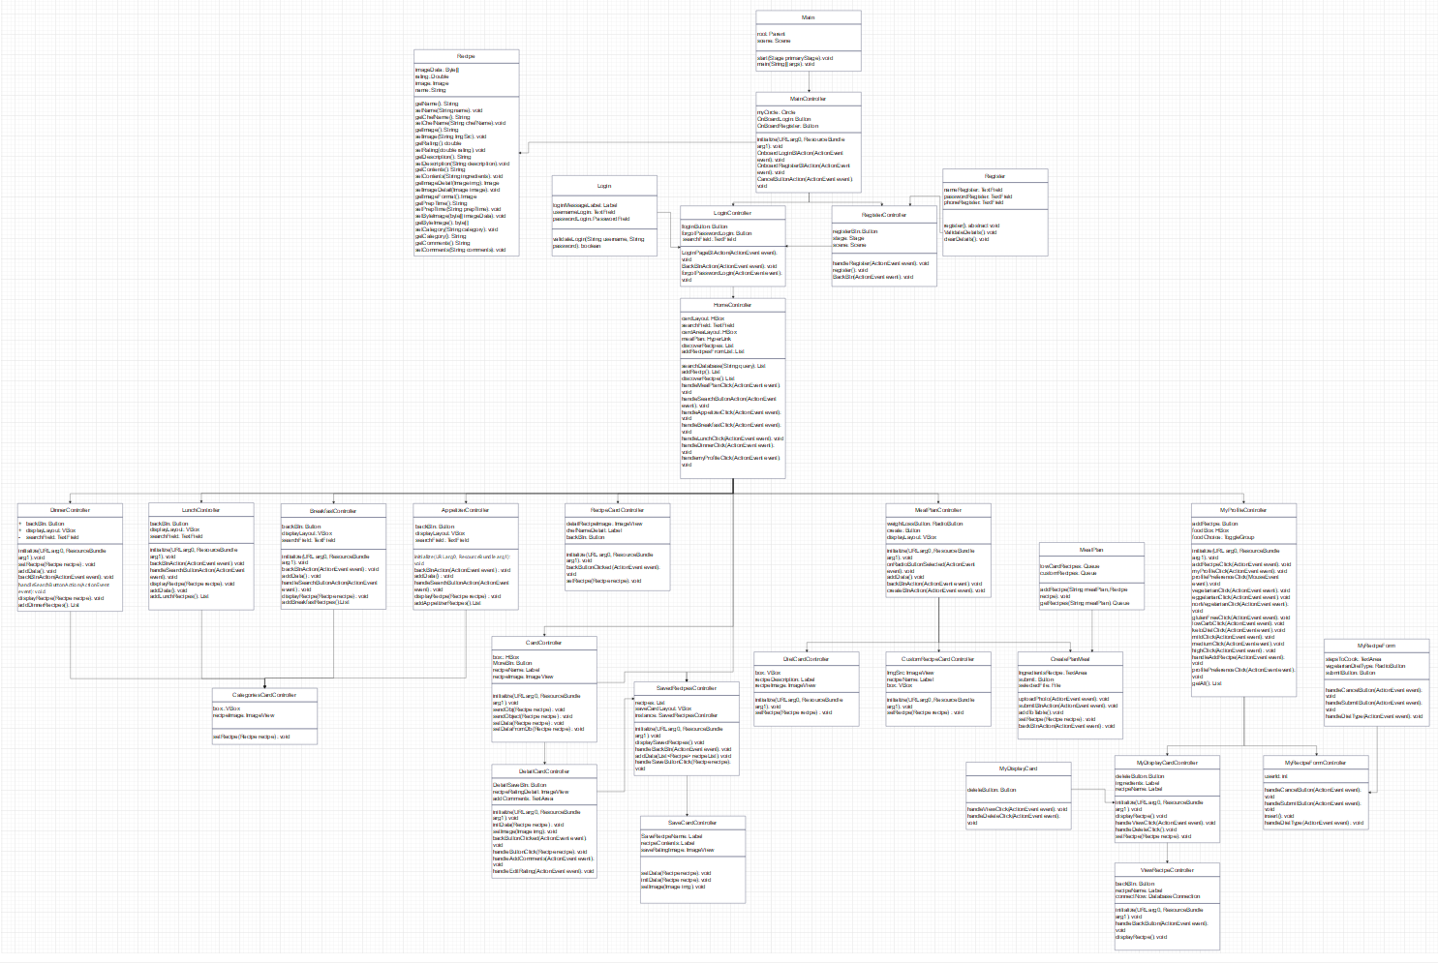
UML Diagram

Slide 14
Future Scopes
Share Recipes
Import and Export recipes
Option to share recipes with others
Option to import and export recipes in various formats
Suggest grocery
Virtual Cooking classes
Based on the meal plans, recommend ingredients for supermarket shopping.
The app might provide users with virtual culinary lessons where they can learn new recipes and cooking skills from experienced chefs.

Slide 15
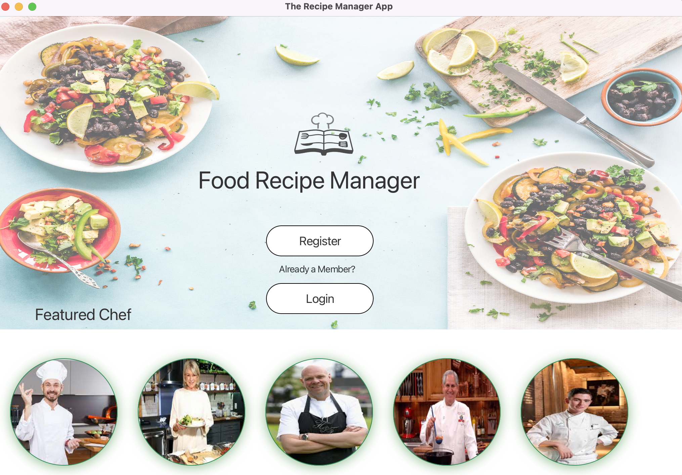
Screenshots of Implementation

Slide 16
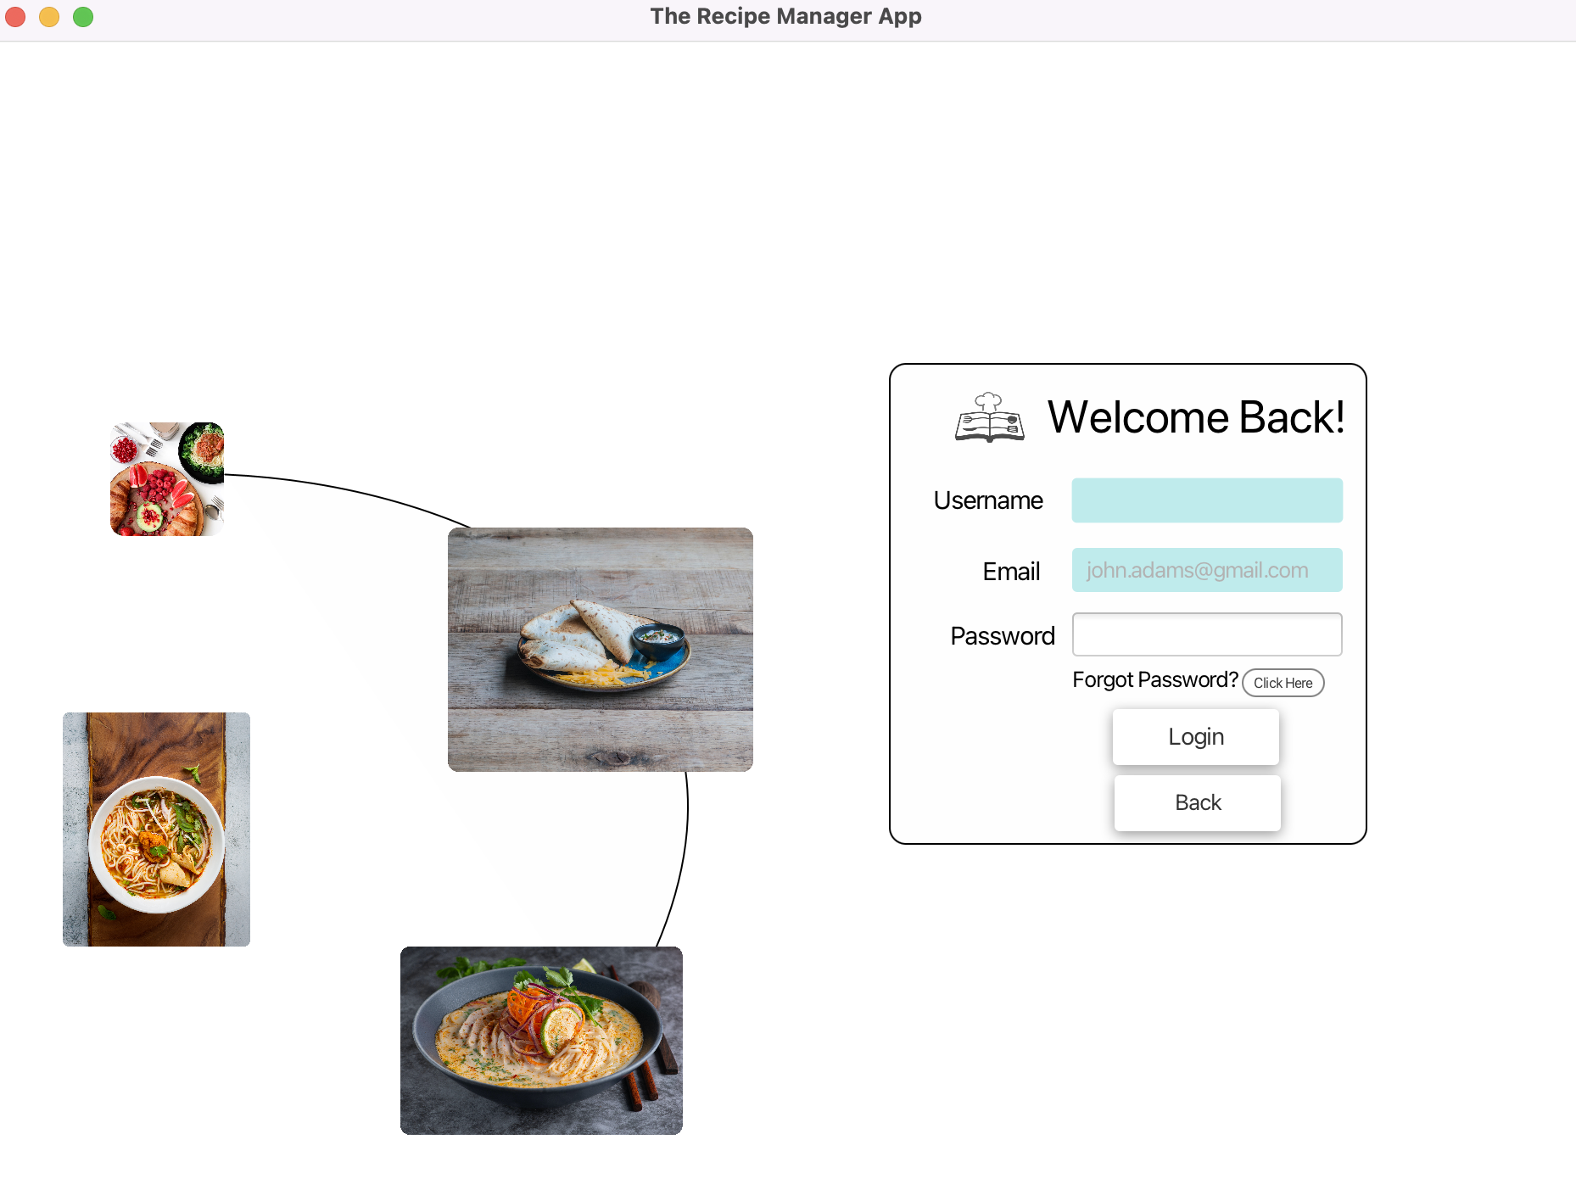
Screenshots of Implementation

Slide 17
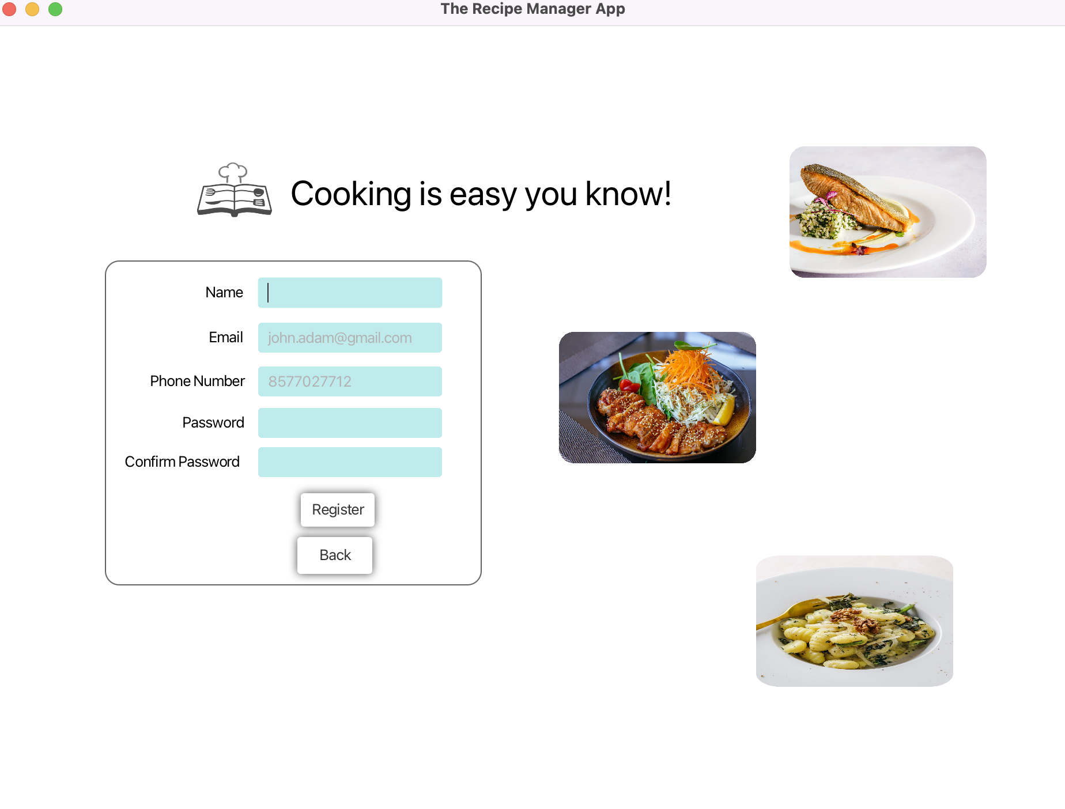
Screenshots of Implementation

Slide 18
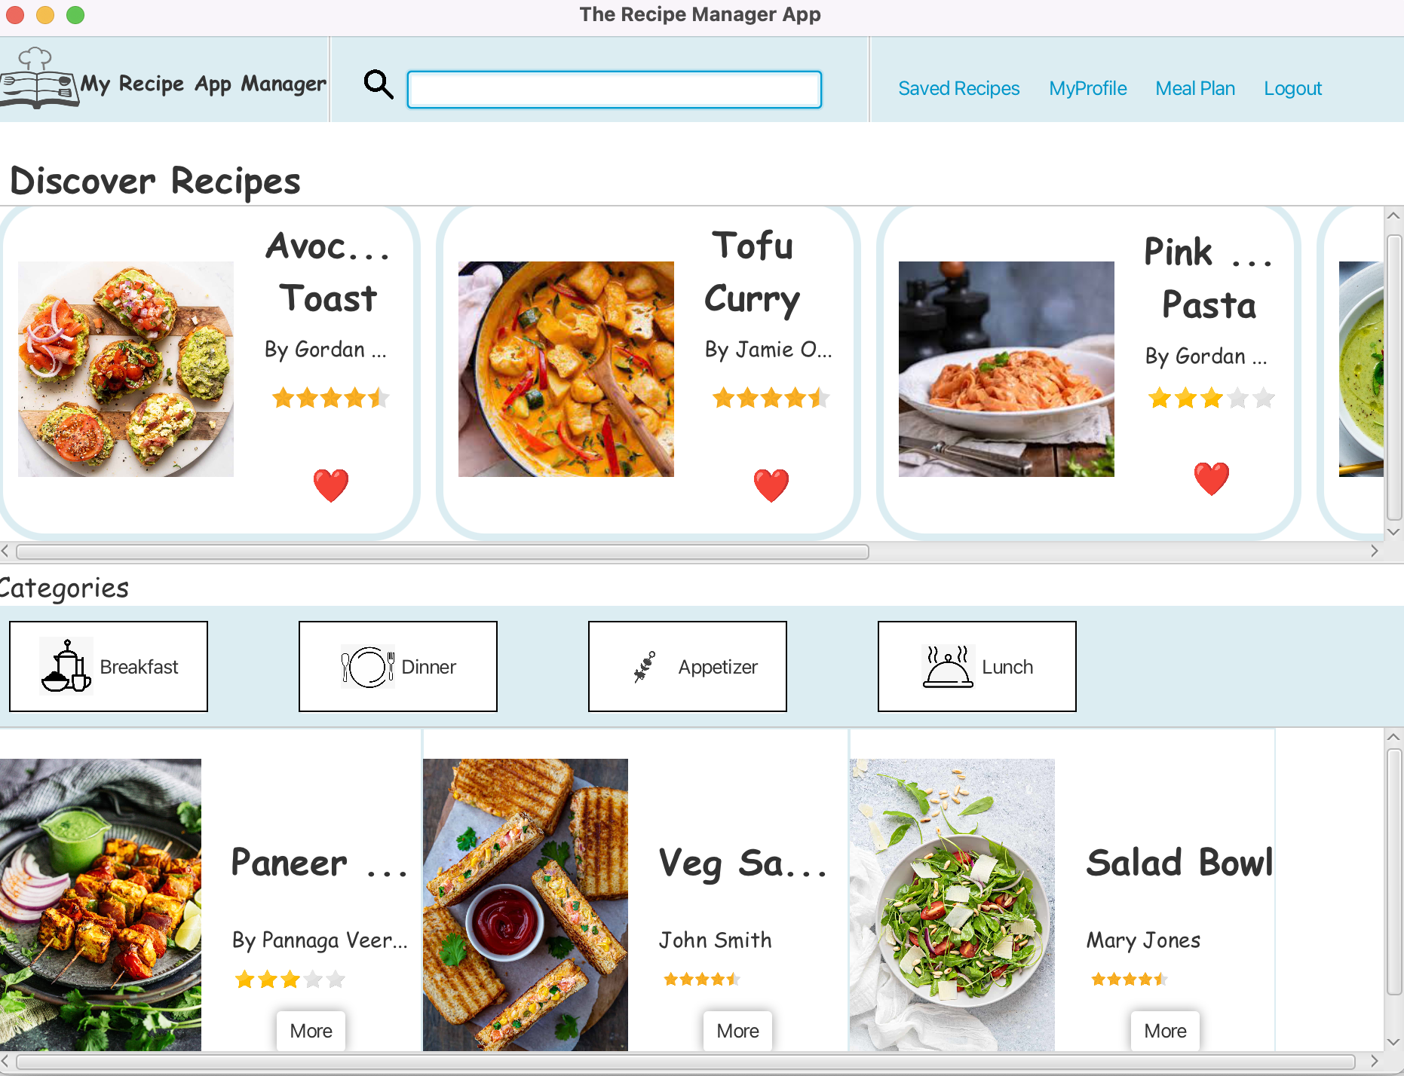
Screenshots of Implementation

Slide 19
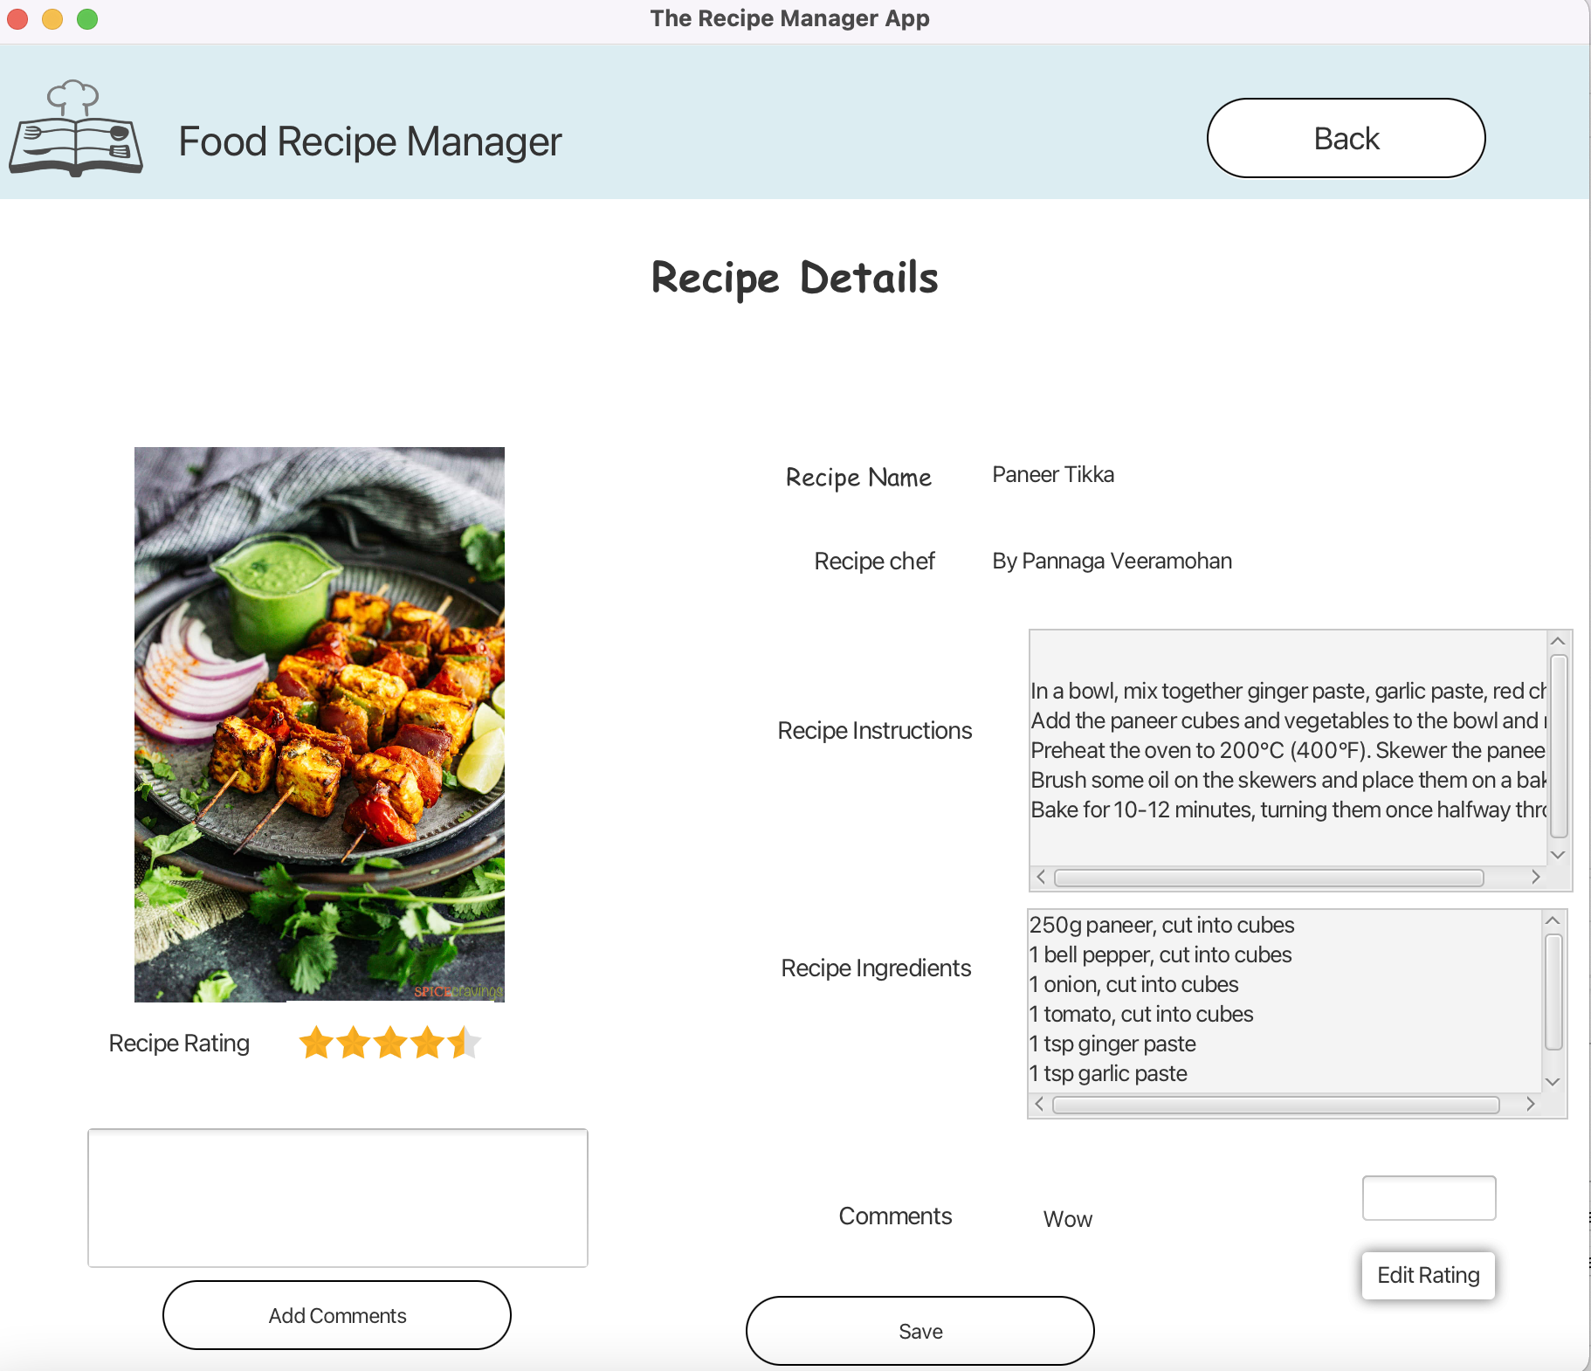
Screenshots of Implementation

Slide 20
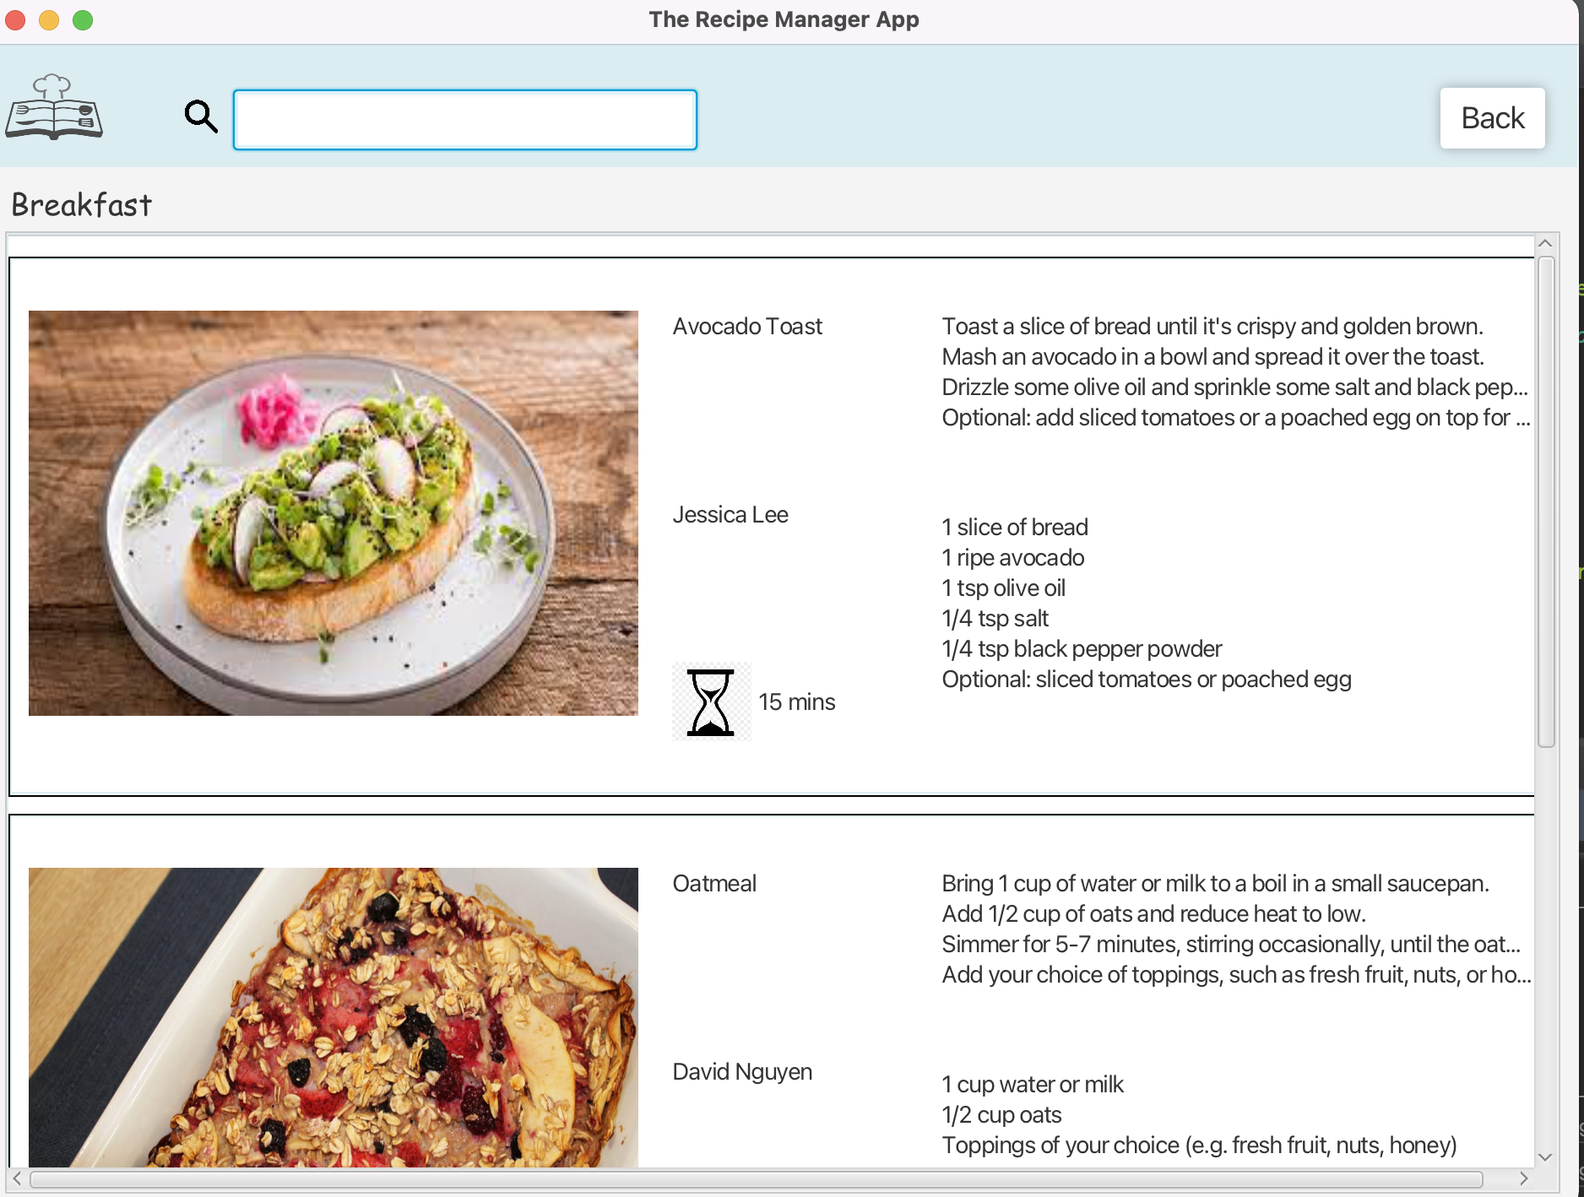
Screenshots of Implementation

Slide 21
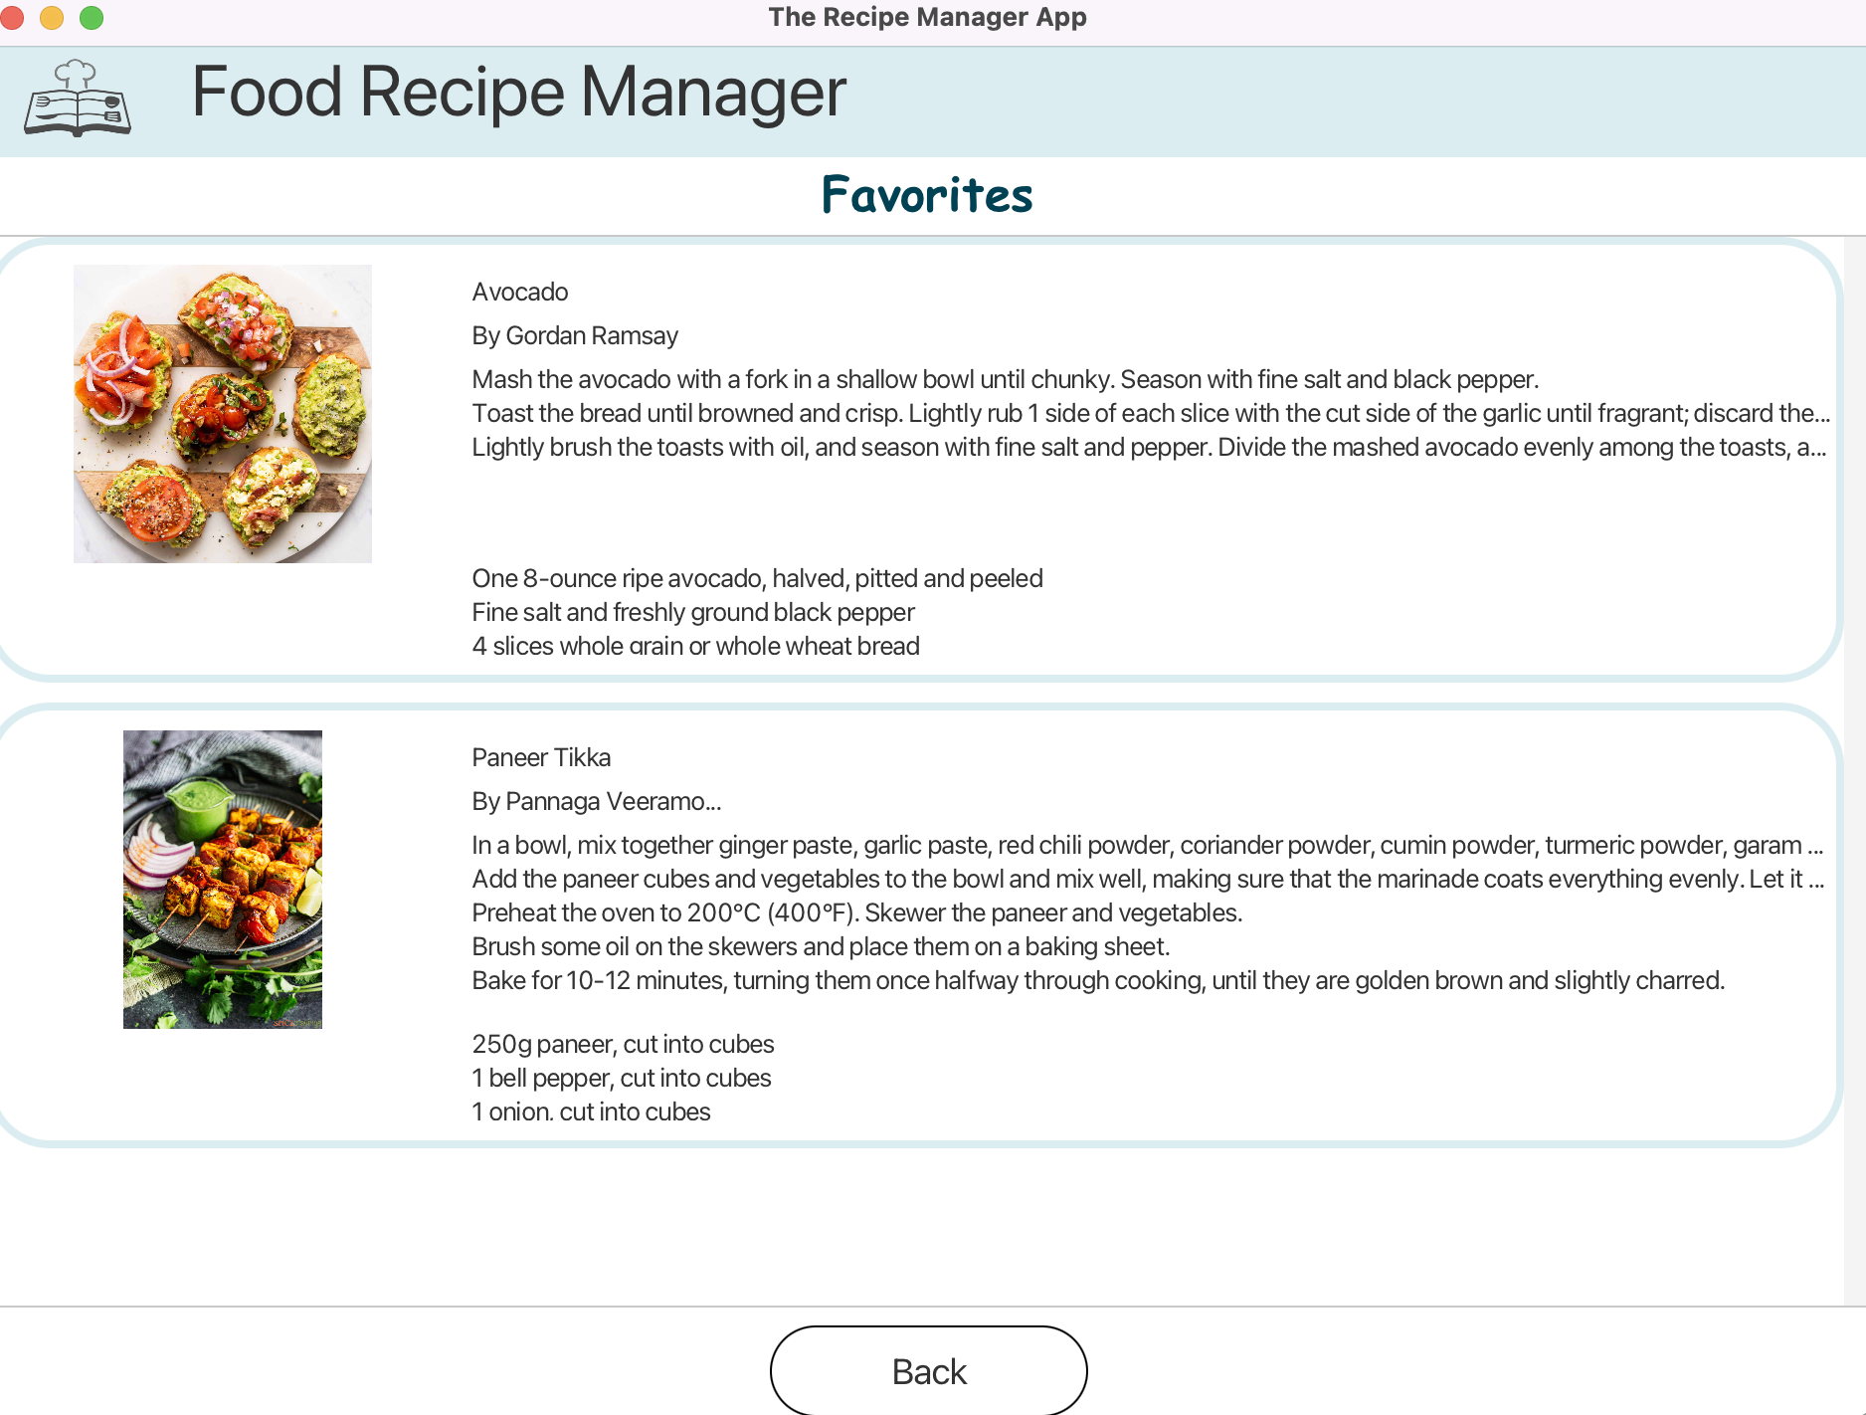
Screenshots of Implementation

Slide 22
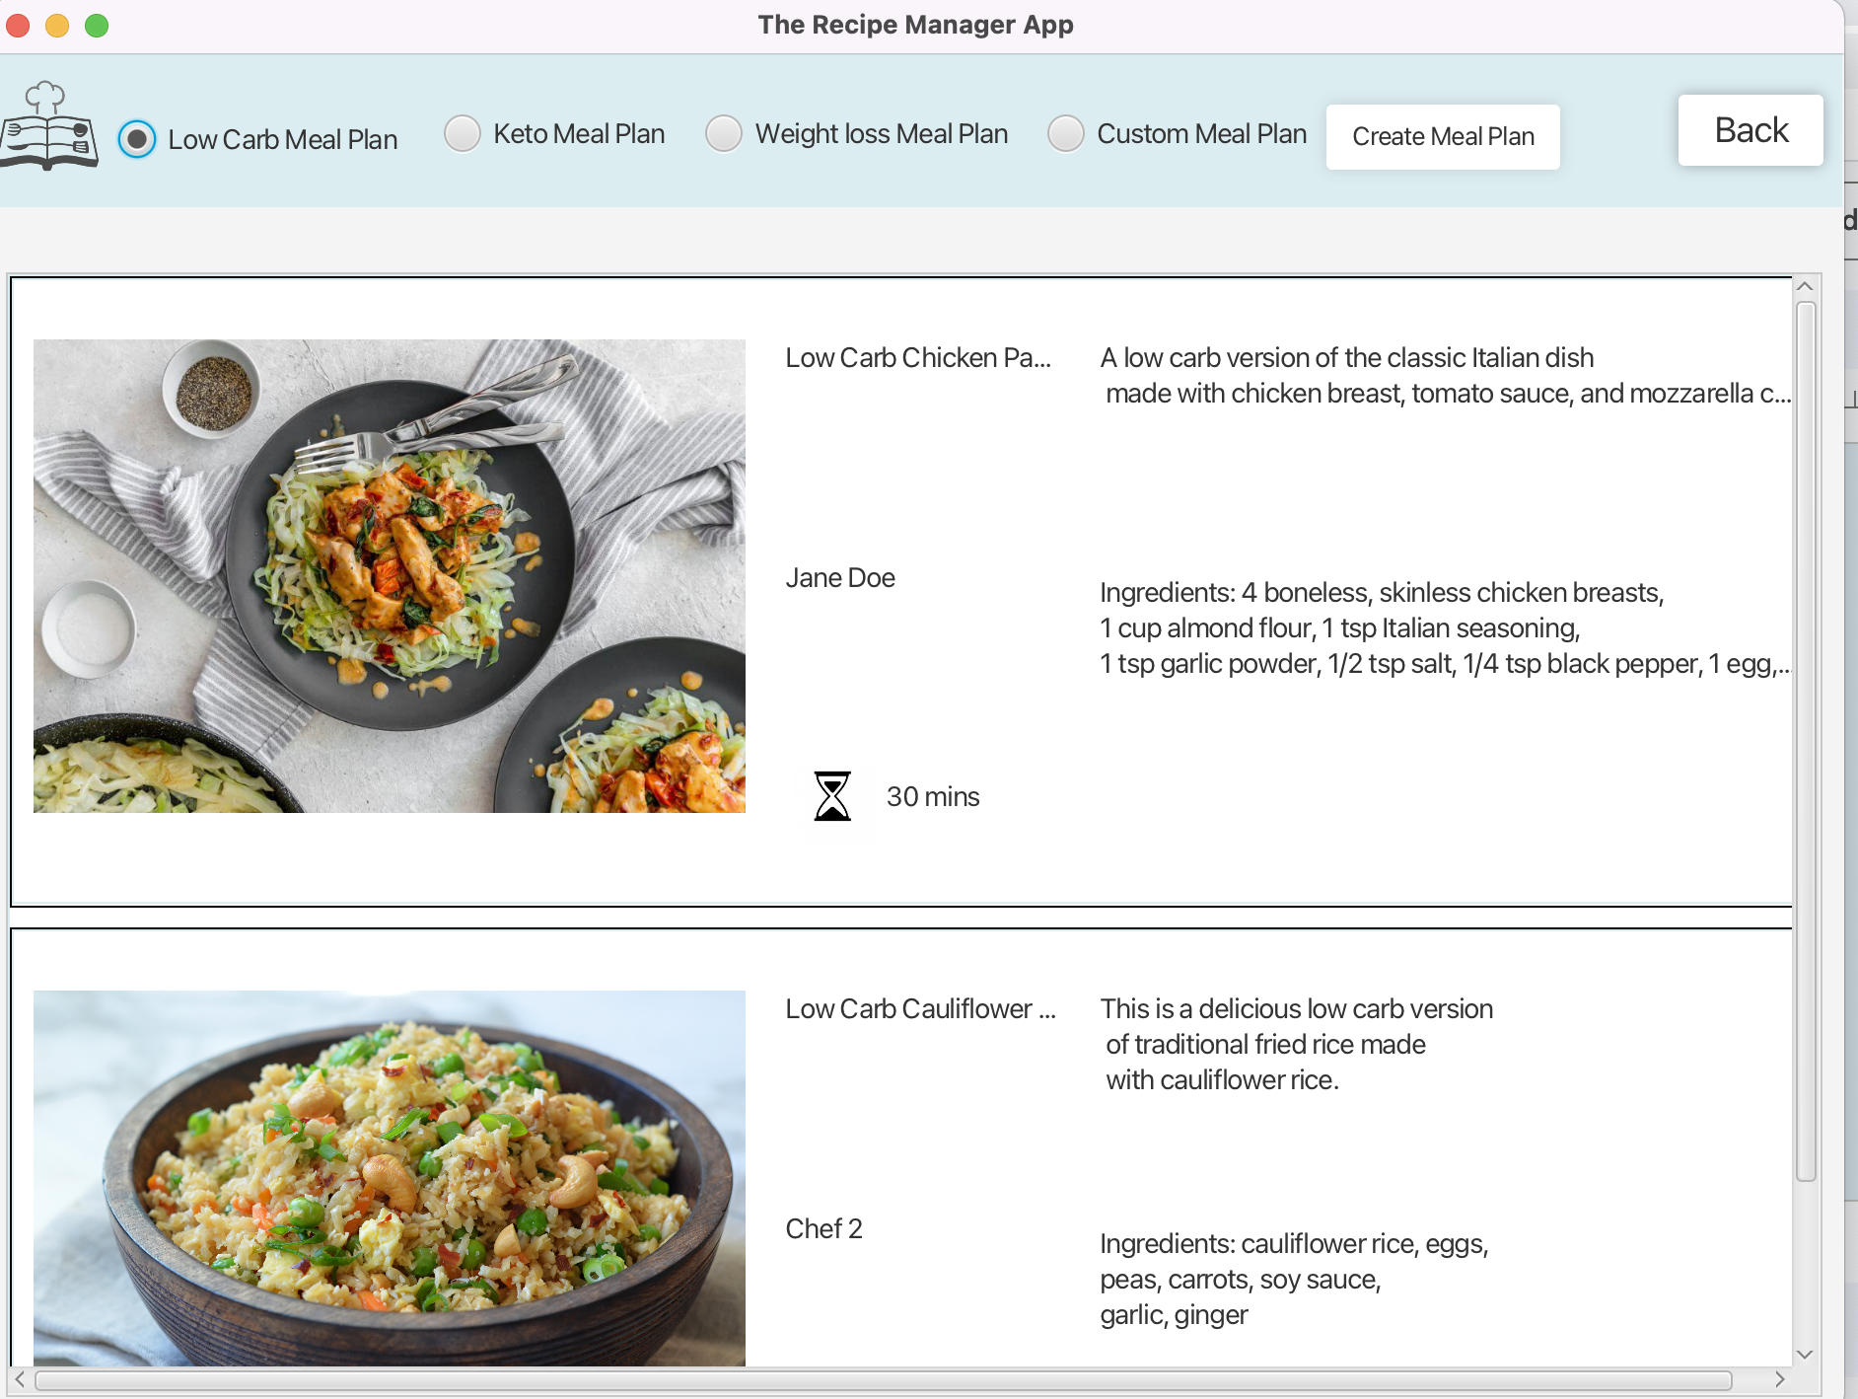
Screenshots of Implementation

Slide 23
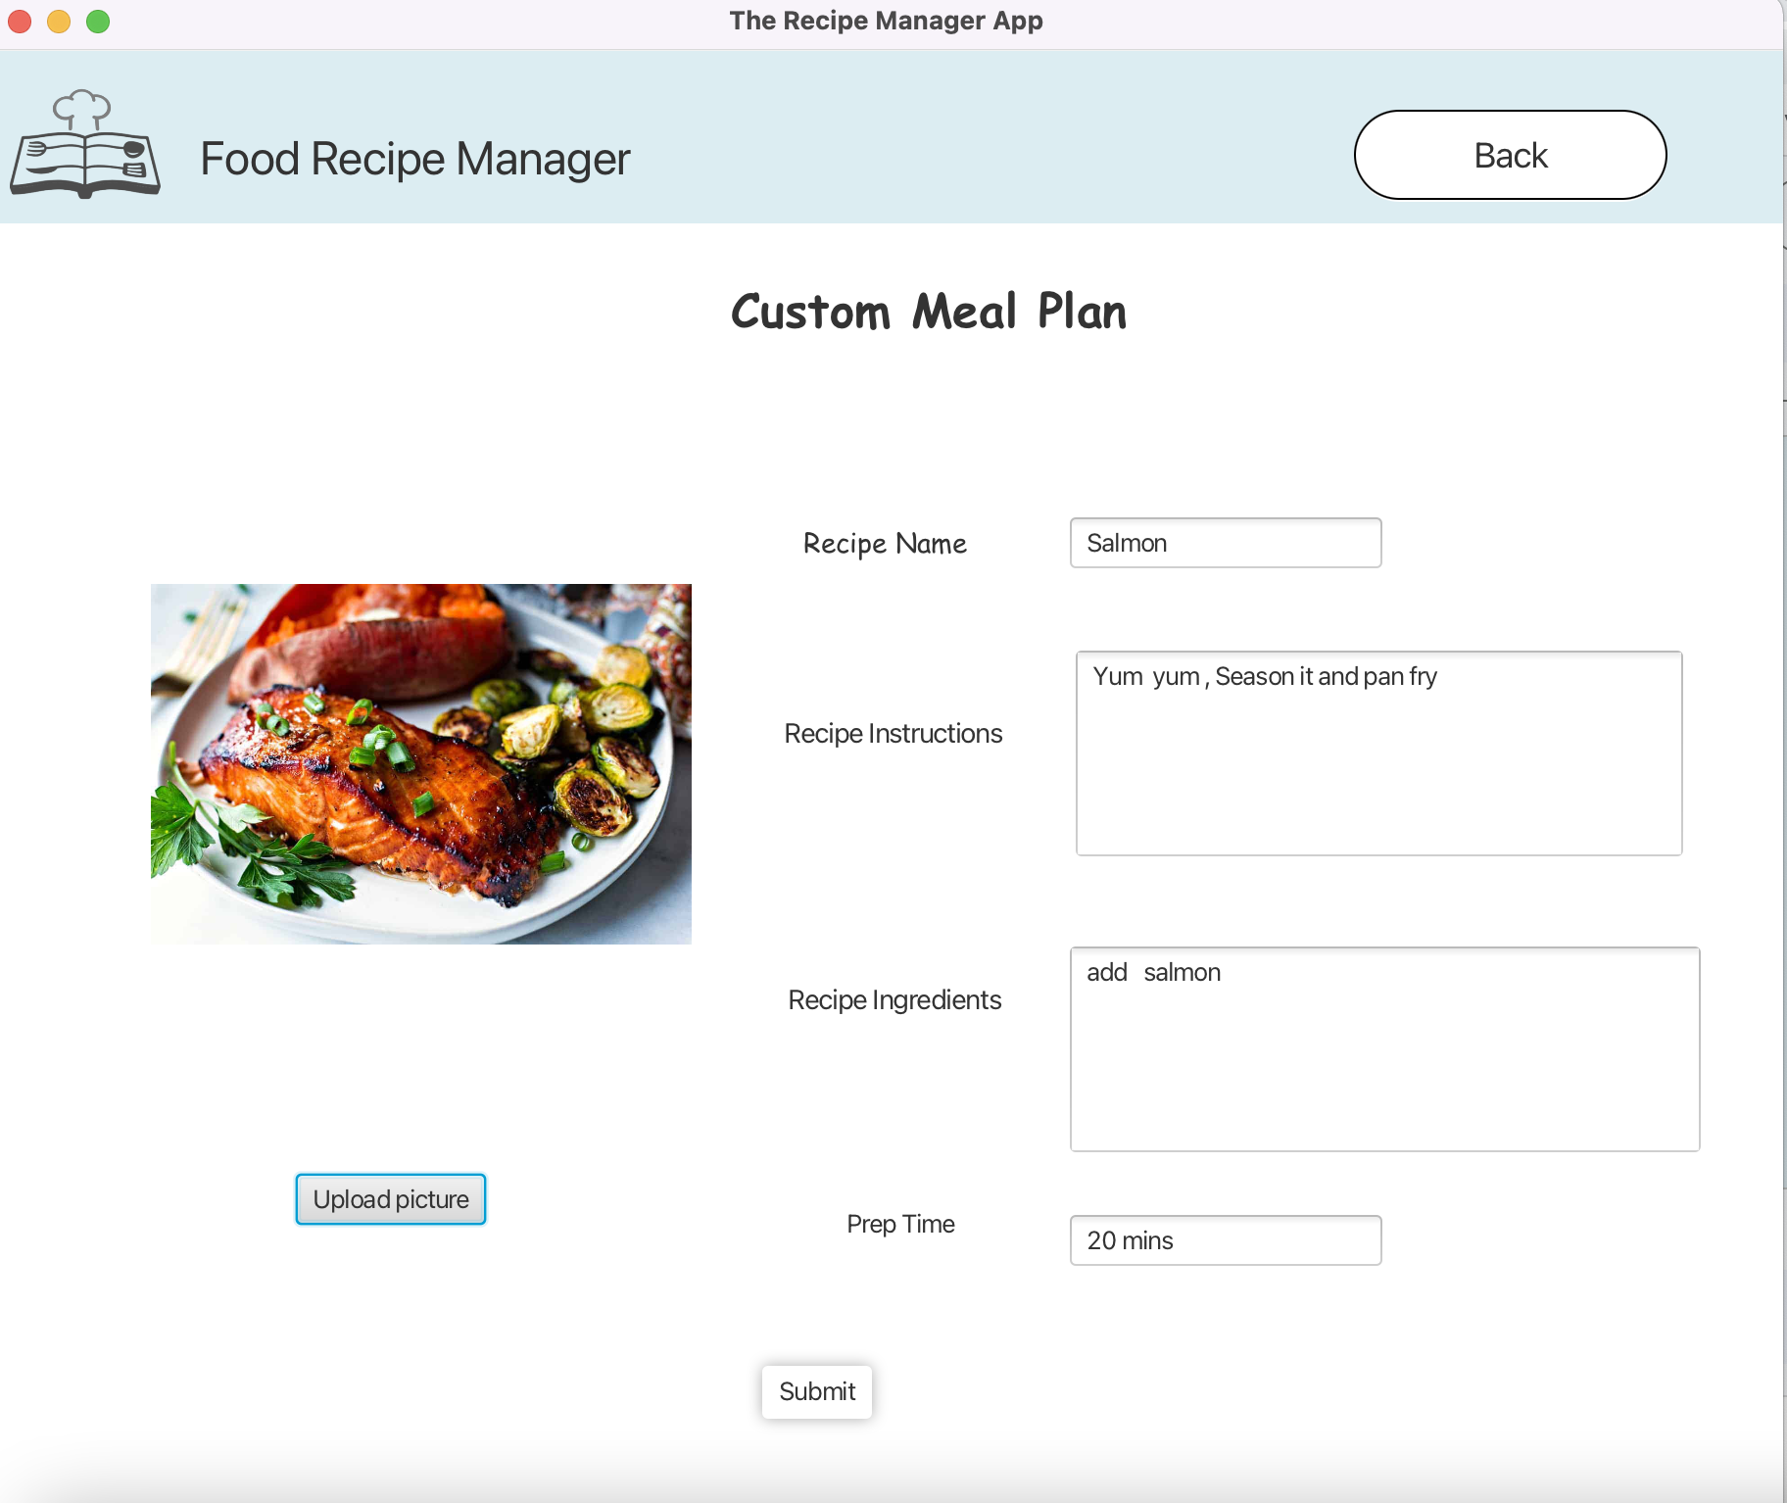
Screenshots of Implementation

Slide 24
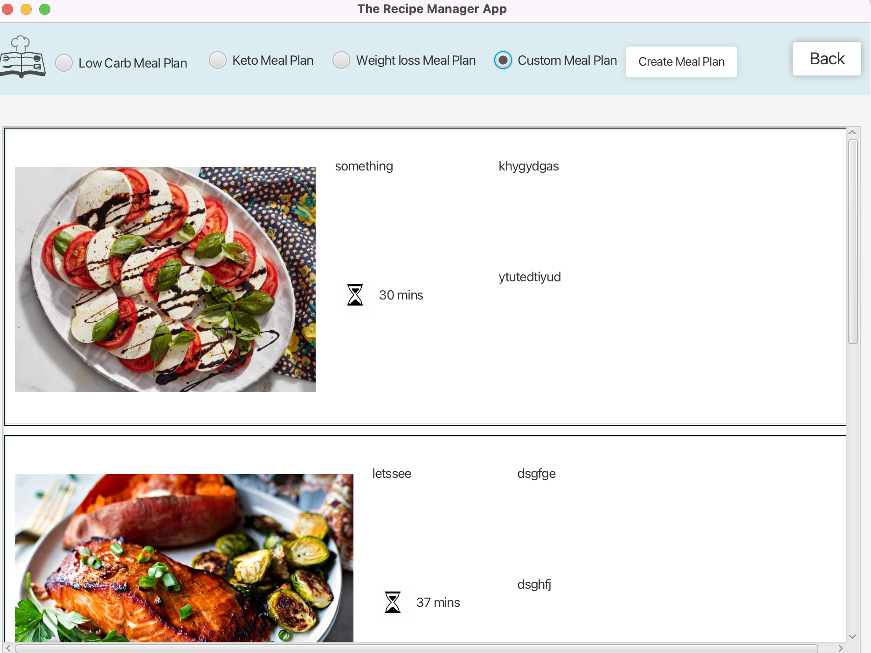
Screenshots of Implementation

Slide 25
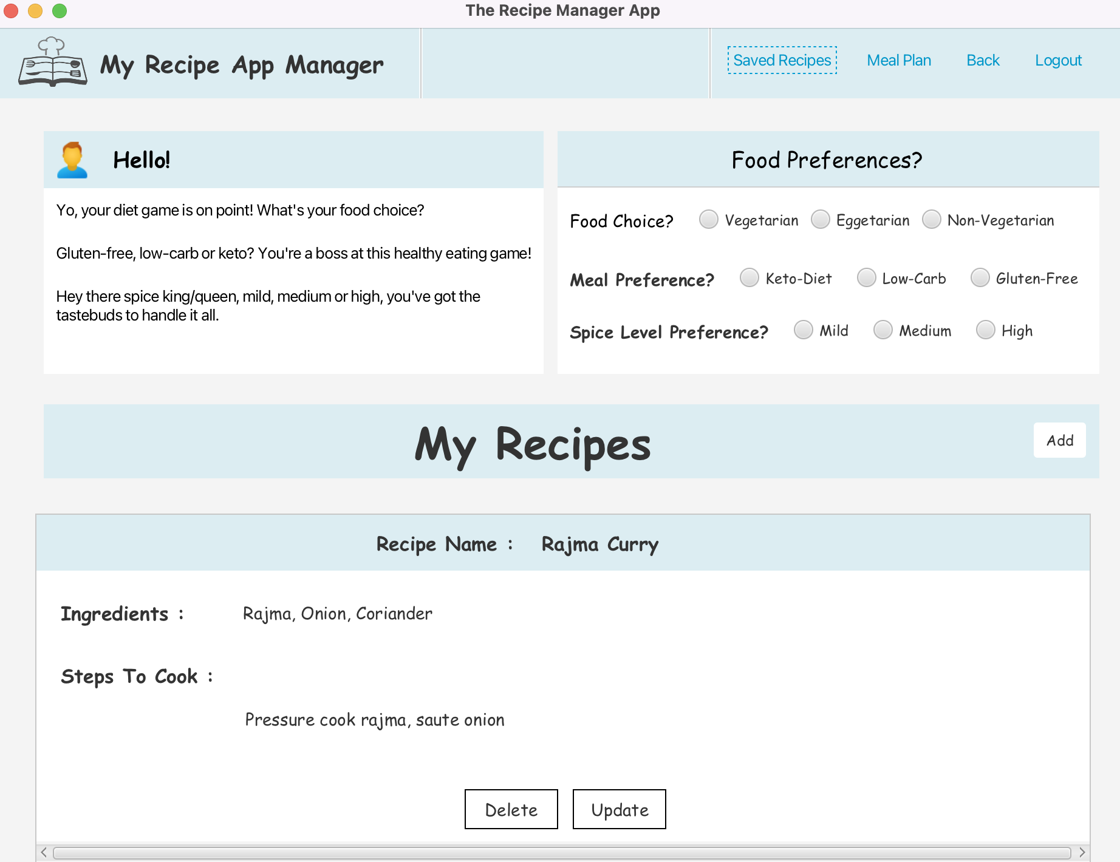
Screenshots of Implementation

Slide 26
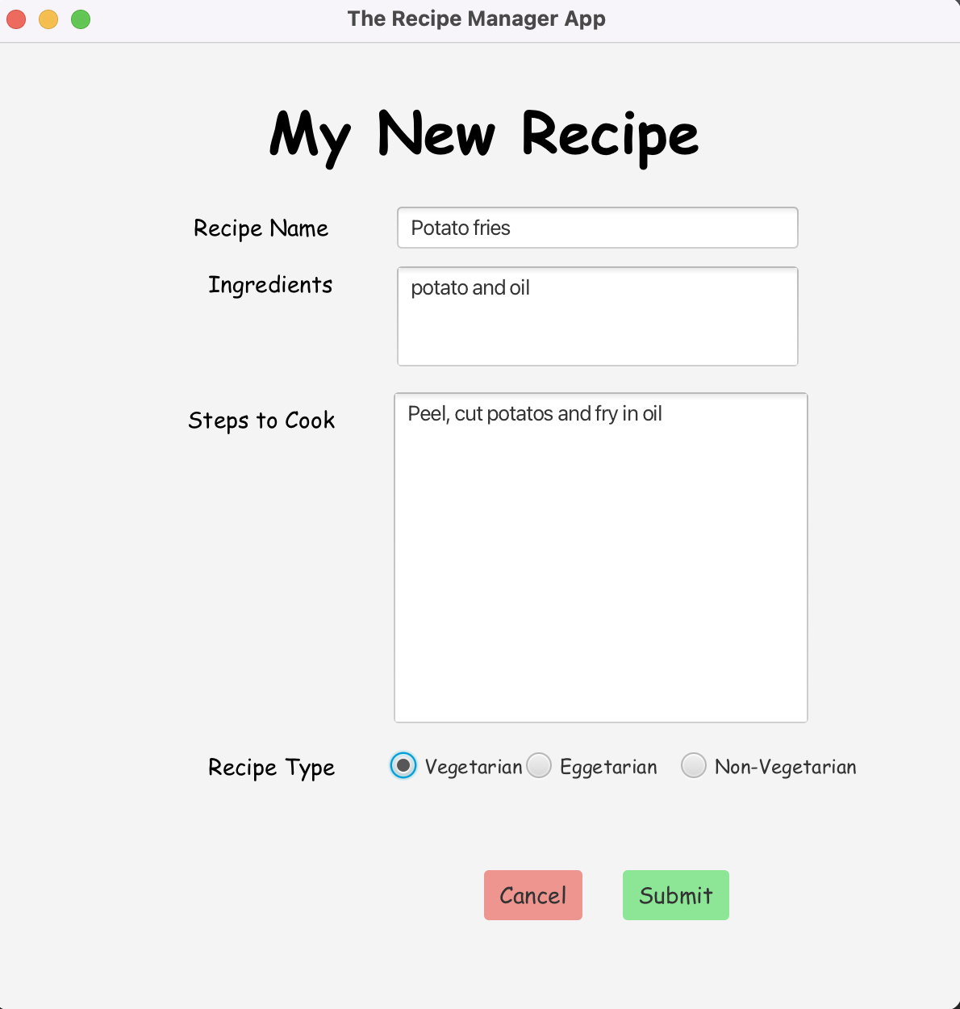
Screenshots of Implementation

Slide 27
Thank you!

